Slide 1


Friends Knitwear & Accessories Ltd
A SISTER CONCERN OF ST GROUP
SINCE 2013
Company Profile
www.friendsknitwear.com

Slide 2
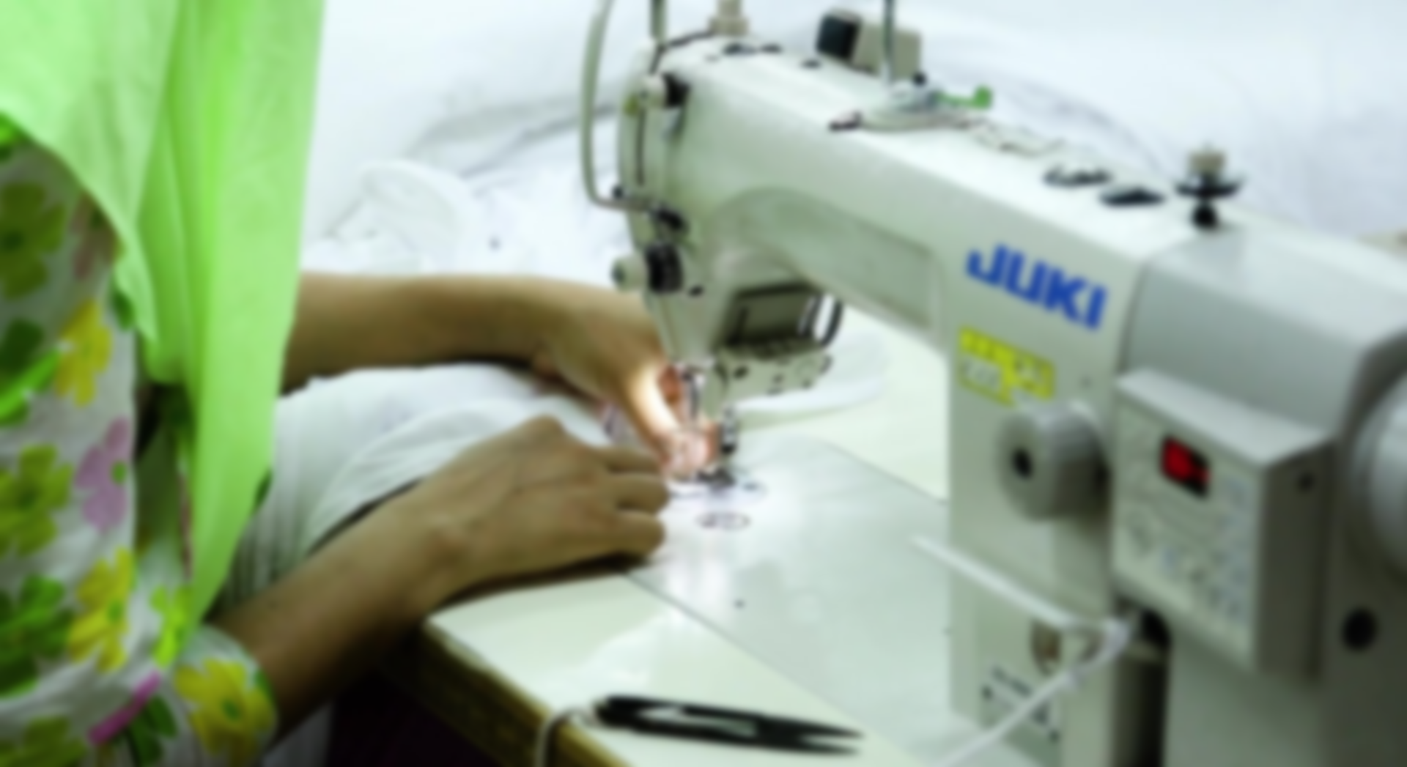
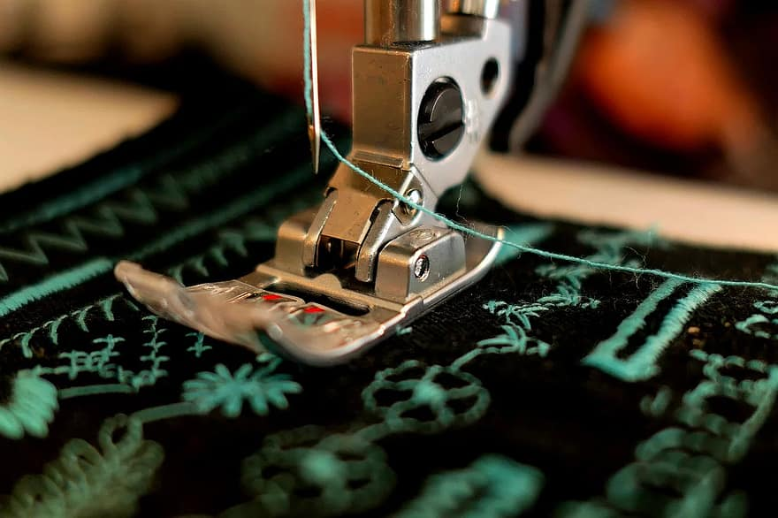
ST Group Profile
v ST Group founded in 2013
v Designing, developing and manufacturing a wide portfolio of high quality
v Employing approximately 670 staff
clothing including Menswear, Womenswear, Childrenswear, Activewear
5 Owned factories: Dhaka Bangladesh
§ Friends Knitwear & Accessories Ltd
§ SARA Knitwear Ltd
§ Friends Knitwear BD
§ Saima Textile Ltd
§ ST Knitwear.
§ sourcing offices : Shanghai-China,
§ Dedicated to the RMG industry-leading standards of excellence in manufacturing with Quality products
www.friendsknitwear.com

Slide 3

What we Say
Friends Knit Wear & Accessories Ltd has been in the textile industry for over 8 years and has
earned its name, value and credibility through the hard work, efforts and strong
commitment towards quality production for each and every one of our clients.
As we face the challenge of continuing to serve our customers in the textile industry, as
the industry changes and evolves, and we ourselves change to better serve all of our
customers across the world, I would like to focus on what does not change, our
commitment to service and quality resulting in the satisfaction of our customers, our
success and our growth.
Ours is an extremely open market, we count our competitors literally by hundreds and
encounter new ones every day. We do not have one single strategy to compete against
so many and so diverse rivals, but I would mention that most of our strategies boil down to
what can be best expressed as: we always strive hard to satisfy our customer’s needs.
www.friendsknitwear.com

Slide 4
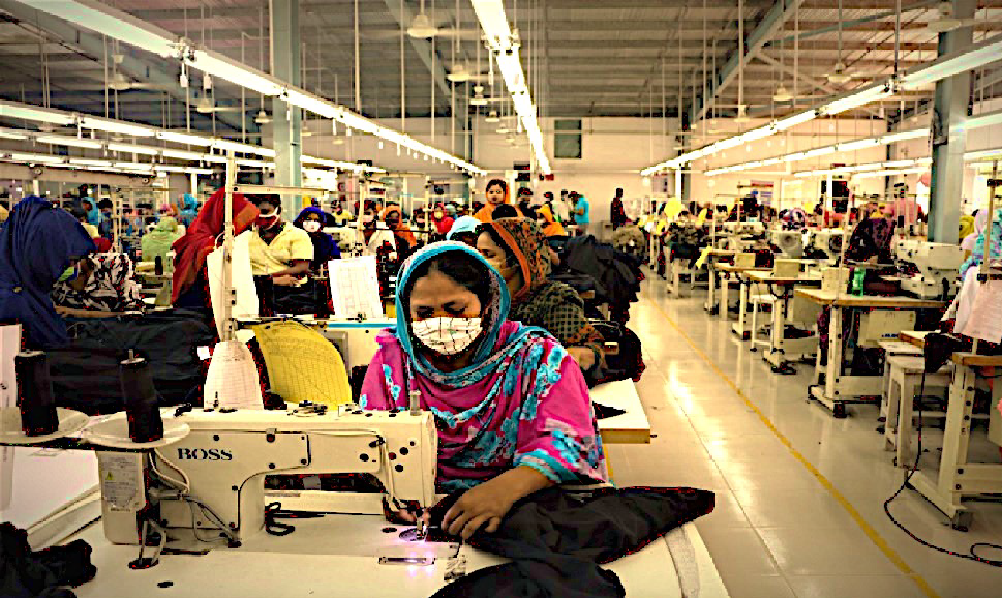
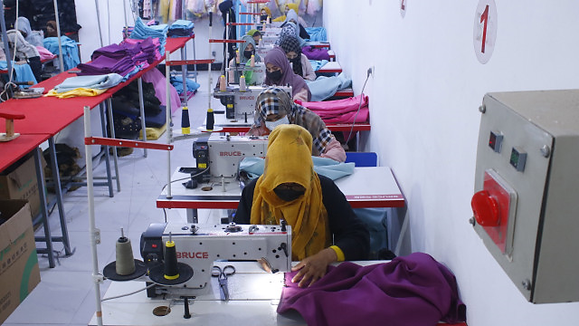
Focus and Our Products Range
Friends Knitwear are dedicate to fashion design, development, sourcing and manufacture. We supply multi
product clothing to a cross section of global retailers. We are able to deliver varying models, meeting the
individual customers requirements. Incorporating Design & Development
Applying the maximum social, ecological and technical standards.
Our product portfolio covers the full range of textiles For Menswear , Womenswear & Kidswear.
vPOLO Shirts
vT-Shirts
vHoody , Jackets , Vest
vTrousers
vSweat Shirt, sportswear, Activewear
vAll Childrenswear
vWASH Products as well
www.friendsknitwear.com

Slide 5
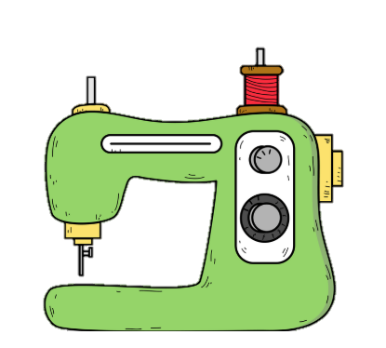


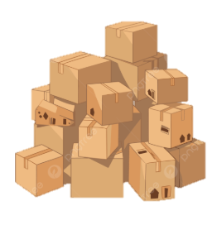


WHY PARTNER WITH US
Manufacturing
Lead Time
Process & Quality
Our dedicated teams ensure high quality and craftsmanship standard remains consistent whether order quantity is 1,000 or 100,000 pieces
>70-90 days from fabrics approval (Local Fabrics) > 90-120 days from fabrics / print design or color selection (imported fabric by sea shipment).
A strict regime of internal audits, critical process check, 3rd party testing on fabric / accessories / garments and Pre-final Inspection @ AQL 2.5 are done prior to shipment.
M O Q
Design & Develop
HR & Policy
Minimum order quantity is 2,000 pieces per color,per style.A large order quantity allows higher efficiency at a reduced manufacturing cost.
We can assist customer creating fits and design for garments. We offer choices of fabrication, wide range of accessories and different packaging method: flat pack, boxed pack, hanging garments, etc.
We follow a strict Code of Conduct (CoC) imbedded in our corporate HR policy – a guideline to follow our company’s rules and regulations and value every individual, including our employees and customers
www.friendsknitwear.com

Slide 6
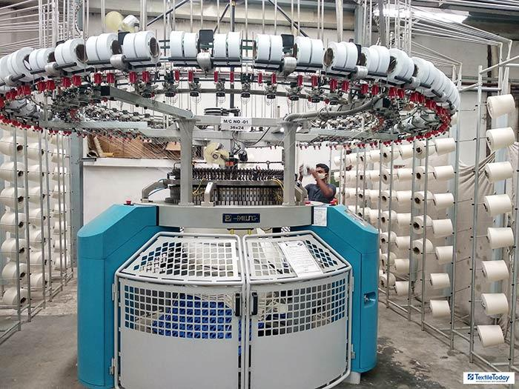
Saima Textile Ltd
Wholly owned facilities in
Taybpur, Zirabo Ashulia,
Savar, Dhaka-1340, Bangladesh
Ø All Knit Fabric Manufacturer
Ø 40 Knitted Machine
Ø 10000kgs per day
Ø Products Type :
Ø Single Jersey , Heavy Jersey
Ø RIB
Ø Interlock
Ø PK , Lacoste,
Ø Terry , Lycra Terry , Fleece
Ø Lycra Full Feeder, Half Feeder , Feeder
Stripe.
Ø Honey Comb, Hearing Bone.
www.friendsknitwear.com

Slide 7
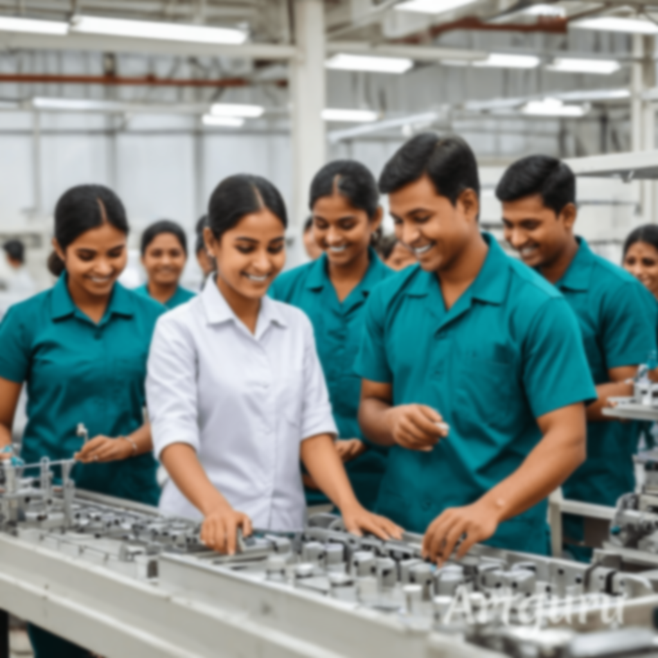
Philosophy
Our Philosophy is a commitment to maintaining and continuously improving our strict quality standards.To ensure that we keep our promise and Commitments.Our Team makes an important contribution to fulfilling our philosophy. Also our Long experience of the RMG, enables us to combine attractive prices with reliable, highly capable suppliers. Our employees are very vital for and always we do care for then .We can clearly see the benefit of being involved whether that be with our employees, their families or the
community in general. We believe in community events that everyone can enjoy.
www.friendsknitwear.com

Slide 8


Our Services
We can provide a complete service to our customer by covering the entire production
process like developments to Finished products or alternatively manufacturing only.
q We have Design and Development
q CAD/CAM technology
q Trim sourcing and Fabric sourcing if necessary.
q Sample making
q We make sure our Quality Assurance
q We Have Highly skilled Technician to ensure our customers’ the “Brand values”.
q visibility and control all process with perfection.
Our aim to provide the BEST possible support to our customer for implementing their requirements.
www.friendsknitwear.com

Slide 9




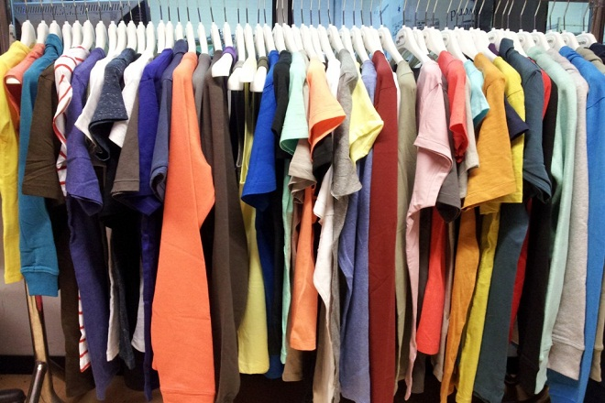
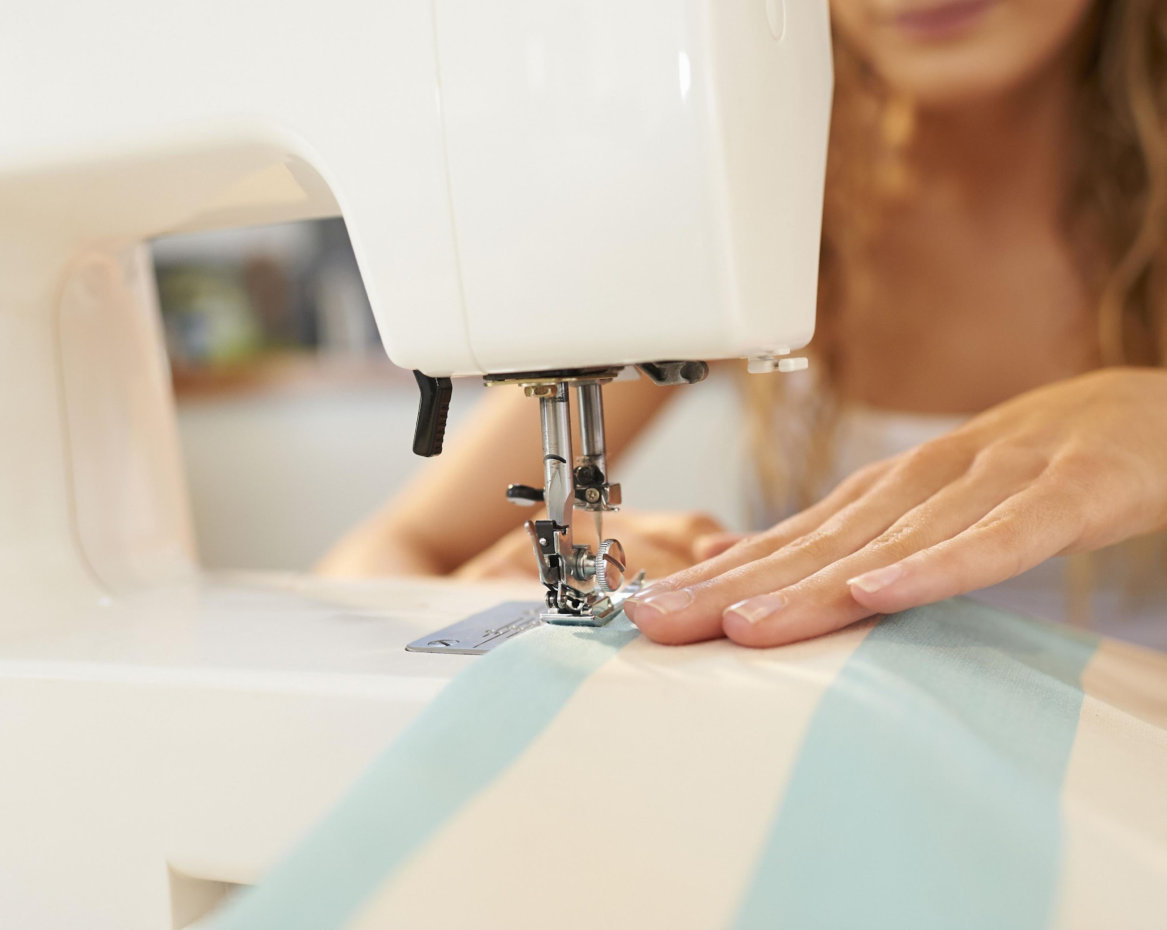
vSTATISTICS
600+
 | 95%
0.5%
 | 500000
300+
 | 10Ton+
Number of Employee
On Time Delivery
Recheck / Rework
Production Capacity / Month
Number of Machine
Per Day Capacity
www.friendsknitwear.com

Slide 10

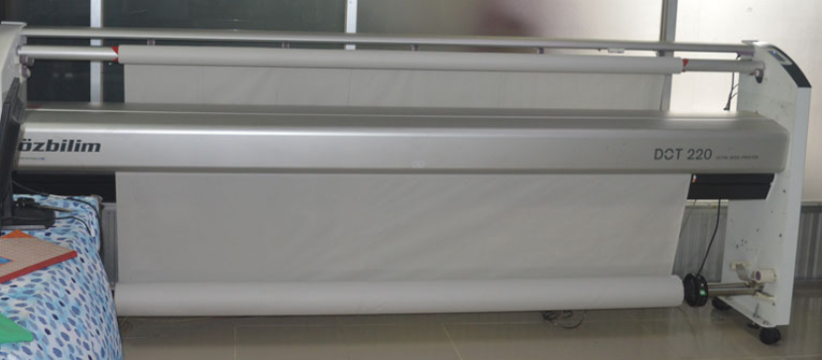
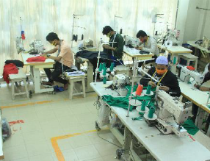
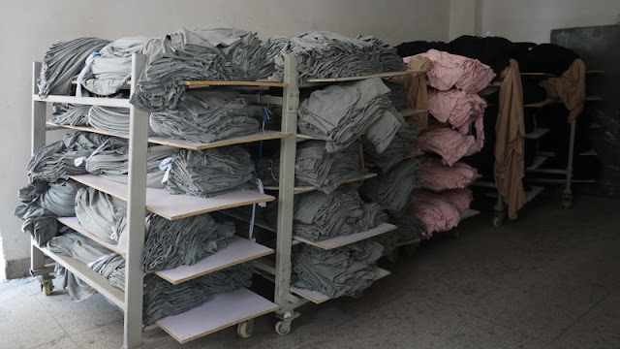
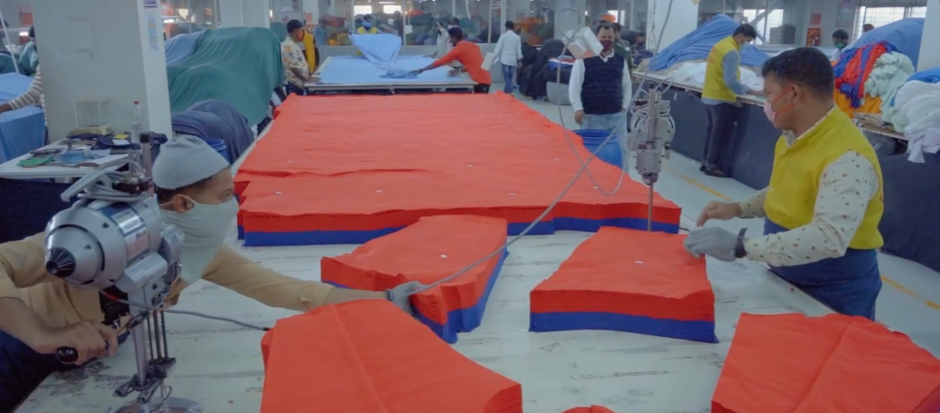
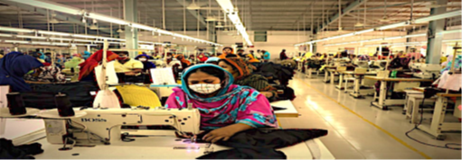
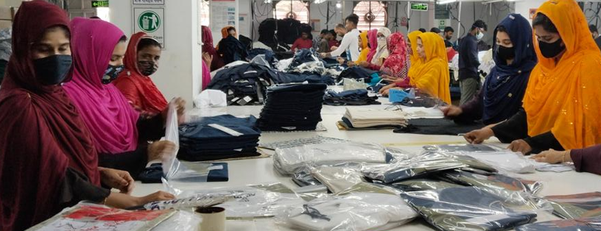
vMANUFACTURING MATRIX
C A D
S A M P L E
F A B R I C S R E L A X A T I O N
C U T T I N G
S T I T C H I N G
F I N I S H I N G
www.friendsknitwear.com

Slide 11
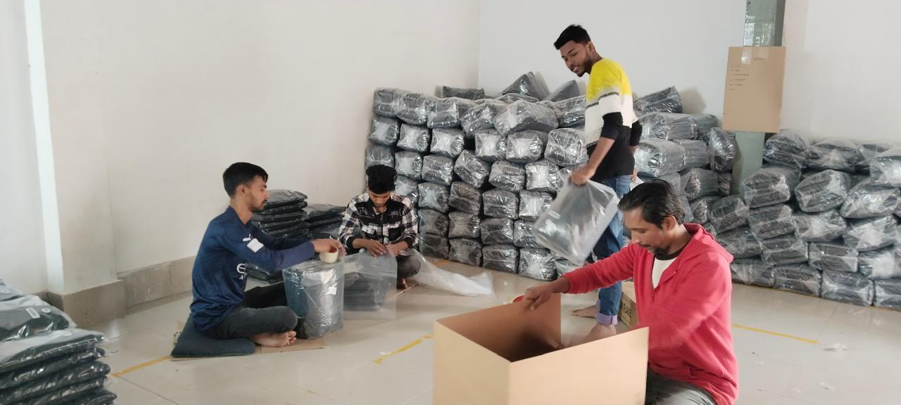
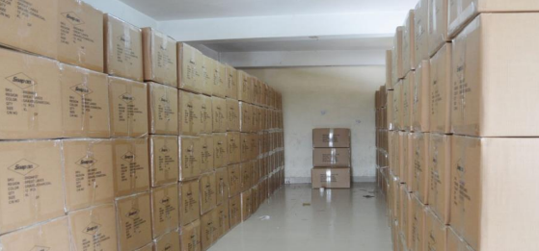
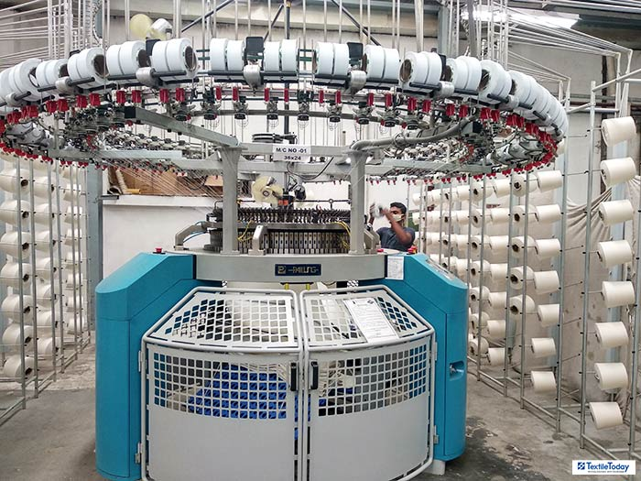
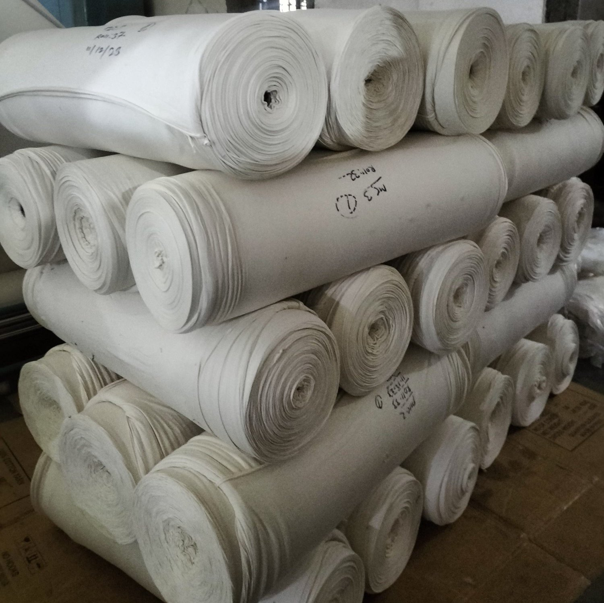
vMANUFACTURING MATRIX
P A C K I N G
F I N I S H E D G O O D S
K N I T T I N G
www.friendsknitwear.com

Slide 12
AWARDS & RECOGNITIONARDS & RECOGNITION
BSCI
Sedex
OEKO-TEX
BCI
PEPCO
www.friendsknitwear.com

Slide 13
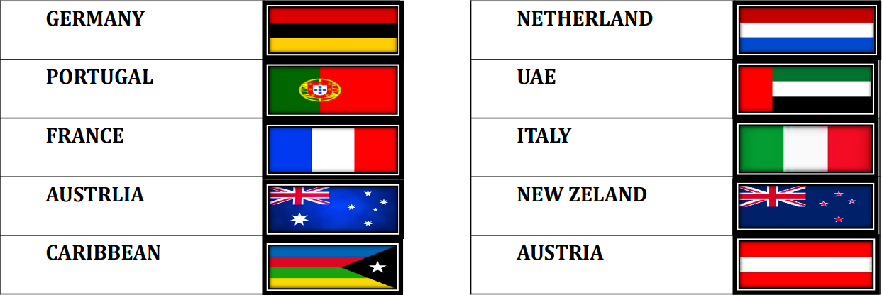





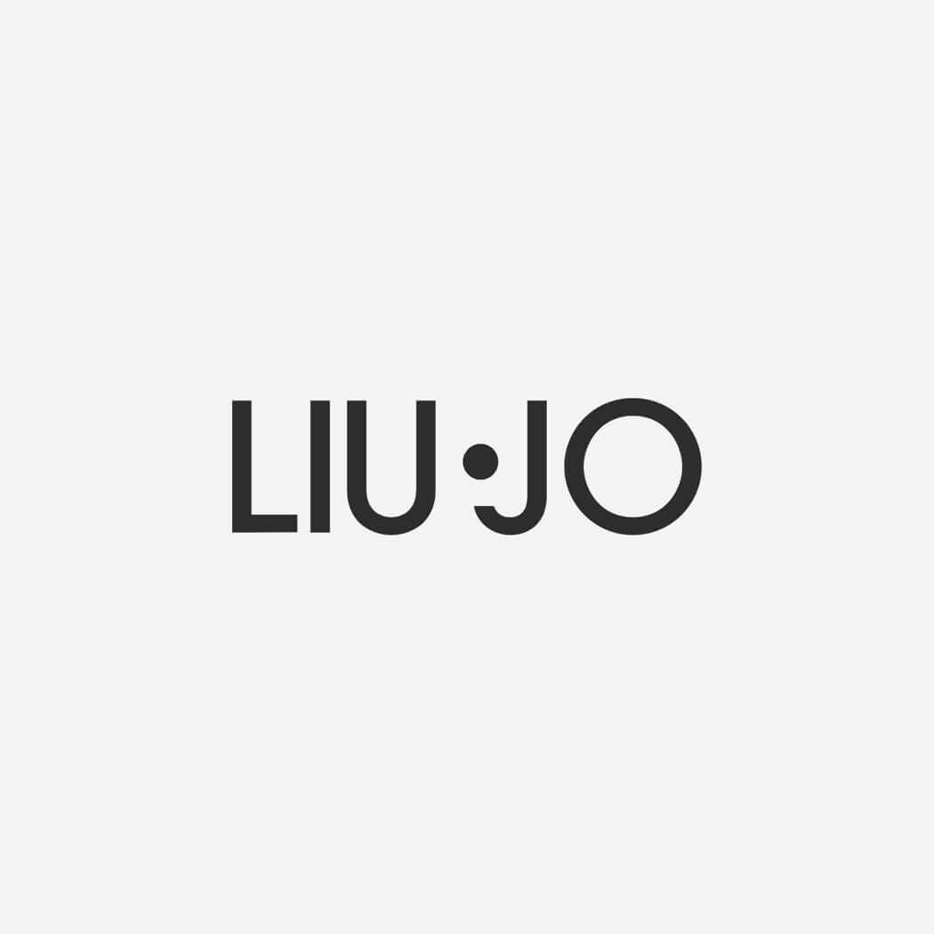







OUR VALUED PARTNER & EXPORT COUNTRIES
CANADA
USA
POLAND
www.friendsknitwear.com

Slide 14
FACTORY MACHINERY
M/C Name | Brand | TOTAL M/C QTY
Overlock Machine | Pegasus/Juki | 86 SET
Plain Machine | Brother/Juki | 113 SET
Flat Lock Machine | Pegasus | 28 SET
Feed Of The Arm | Brother | 2SET
Button Hool Machine | Brother/Juki | 2SET
Button Stitch Machine | Brother/Juki | 2SET
PMD Kansai | Kansai | 1SET
Pecoting Kansai | Kansai | 1SET
Snup button | Full Automatic Servo Snap Button Machine | 2SET
BARTAKE | Brother/Juki | 2SET
Rib Cutting | auto rib cutting machine | 3SET
 |  | 242SET
www.friendsknitwear.com

